Slide 1
GANs, DCGANs, & Conditional GANs: Structure, Algorithm, Applications
Presented By:
Erica Payne
Leonardo Ramirez
Leonard Garcia
Jackson Bentley
Angel Villalobos
Jesus Cruz
David Camacho
Ly Jacky Nhiayi
Youssef Elzein
Matthew Johnson

Slide 2
Introduction
Overview of GAN (Generative Adversarial Networks)
Structure of GAN
Algorithms
DCGANs (Deep Convolutional Generative Adversarial Networks)
Conditional GAN
Applications of GAN
Demonstration
Conclusion / Summary

Slide 3
Introduction / Overview of GANs
Presenter: Erica Payne

Slide 4
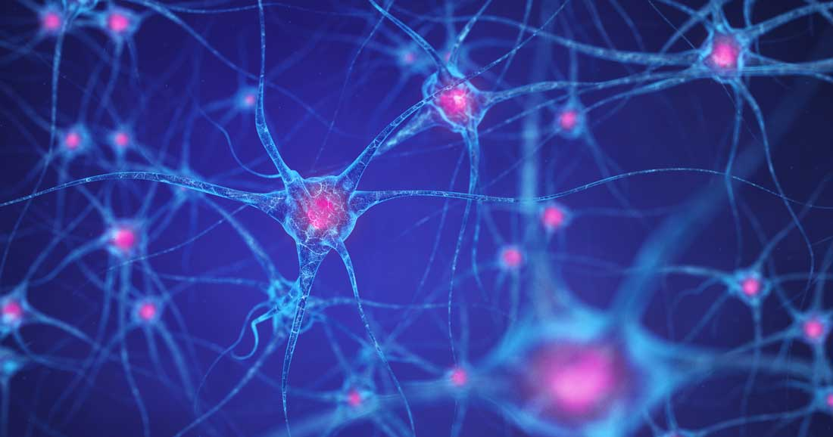
What is GAN? (Generative Adversarial Networks)
A GAN is a machine learning model in which two neural networks compete with each other using deep learning methods to become more accurate. GANs are in innovation in machine learning.
They run unsupervised typically and use a cooperative zero-sum game framework to learn, where one person’s gain is another person’s loss.
Notes:
GANs are in innovation in machine learning.

Slide 5
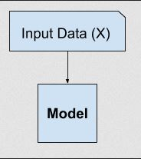
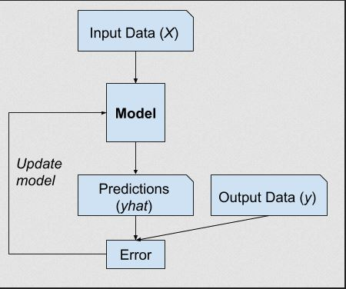
Supervised vs. Unsupervised Learning
Supervised Learning
Unsupervised Learning
Examples of SL problems:
Classification
Regression
SL Algorithms:
Logistic Regression
Random Forest
Examples of UL problems:
clustering
generative modeling
UL Algorithms:
K-means
Generative Adversarial Networks
Notes:
Supervised Learning
A typical ML problem involves using a model to make a prediction. Doing this requires having a training dataset that is used to train the model, that is comprised of multiple examples called samples, and each of these samples have input variables (X)
and output class labels (y).
A model is trained by showing examples of inputs, having it predict the outputs, and then correcting the model to make the outputs more like the expected outputs. This correction of the model is called supervised learning
Unsupervised learning
where the model is only given the input variables (X) and the problem does not have any output variables (y).
A model is constructed by extracting or summarizing the patterns in the input data. There is no correction of the model, as the model is not predicting anything.

Slide 6
GAN Explained
Generative
Adversarial
Networks
Generative models are models that can generate their own data samples that resemble the training data received.
This describes the training environment for each neural network.
Generative models are made up of two types of neural networks
Notes:
There are many kinds of generative models and GANs are just one kind of them
Adversarial learning means just that it trains two different networks and pits them against each other. One network generates new data by taking an input data sample and modifying it as much as possible. The other network tries to predict whether the generated data output belongs in the original dataset.

Slide 7
GAN Structure
Generator
Discriminator
These are convolutional neural networks (CNN), which is a deep learning algorithm that can process an input image, differentiate between the objects within it, and assign importance to each other.
These are deconvolutional neural networks (DNN). These algorithms work in reverse to CNNs, and aim to identify the features of an input that were either missed by the CNN or convoluted with other signals.

Slide 8
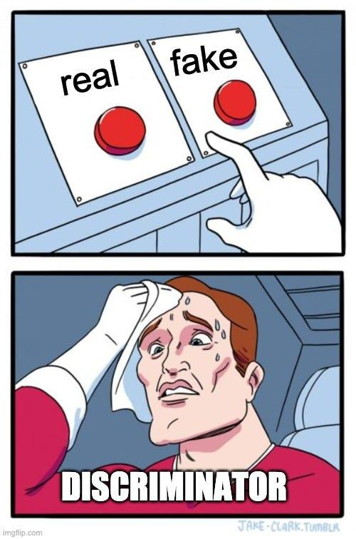
Neural Networks of GANs
Generator’s Goal
To artificially manufacture outputs that can be mistaken for real data.
Discrimator’s Goal
To identify which of the outputs it receives have been artificially made/created.
Notes:
So when training, the generator produces obviously fake data and the discriminator quickly learns to tell that it is fake.

Slide 9
Types of GANs
Conditional GANs (CGANs)
Deep Convolutional GANs (DCGANS)
This introduces the concept of conditionality that allows for targeted data generation.
The generator and discriminator receive additional information, typically as class labels or some other form of conditioning data.
Recognizing the power of convolutional neural networks (CNNs) in image processing, Deep convolutional GAN (DCGAN) integrates CNN architectures into GANs.
With DCGAN, the generator uses transposed convolutions to upscale data distribution, and the discriminator also uses convolutional layers to classify data.
Notes:
There are numerous other GAN types that solve different types of problems. Depending on the mathematical formulas used and the different ways the generator and discriminator interact with each other.
CGANs
For instance, if generating images, the condition could be a label that describes the image content. Conditioning allows the generator to produce data that meets specific conditions.
DCGANs
The DCGAN also introduces architectural guidelines to make training more stable.

Slide 10
Examples of GAN Uses
>
>
>
>
>
>
Create Training Data
Increase Image Resolution
Morph Audio
Generate Human Faces
Video Game Character Creation
Develop New Fashion Designs
Notes:
GANs are used to generate a wide range of data, including images, Music and text.
Creating data (train a classifier but don’t have enough data)
If you want to increase image resolution without having to introduce artifacts.
Or realistically morph audio from one speaker to another without having identical recordings from both speakers
GANs can produce accurate representations of human faces
GANs can be used to create new characters for video games.
GANs can be used to create new fashion designs that reflect existing ones.

Slide 11
Structure of GANs

Slide 12
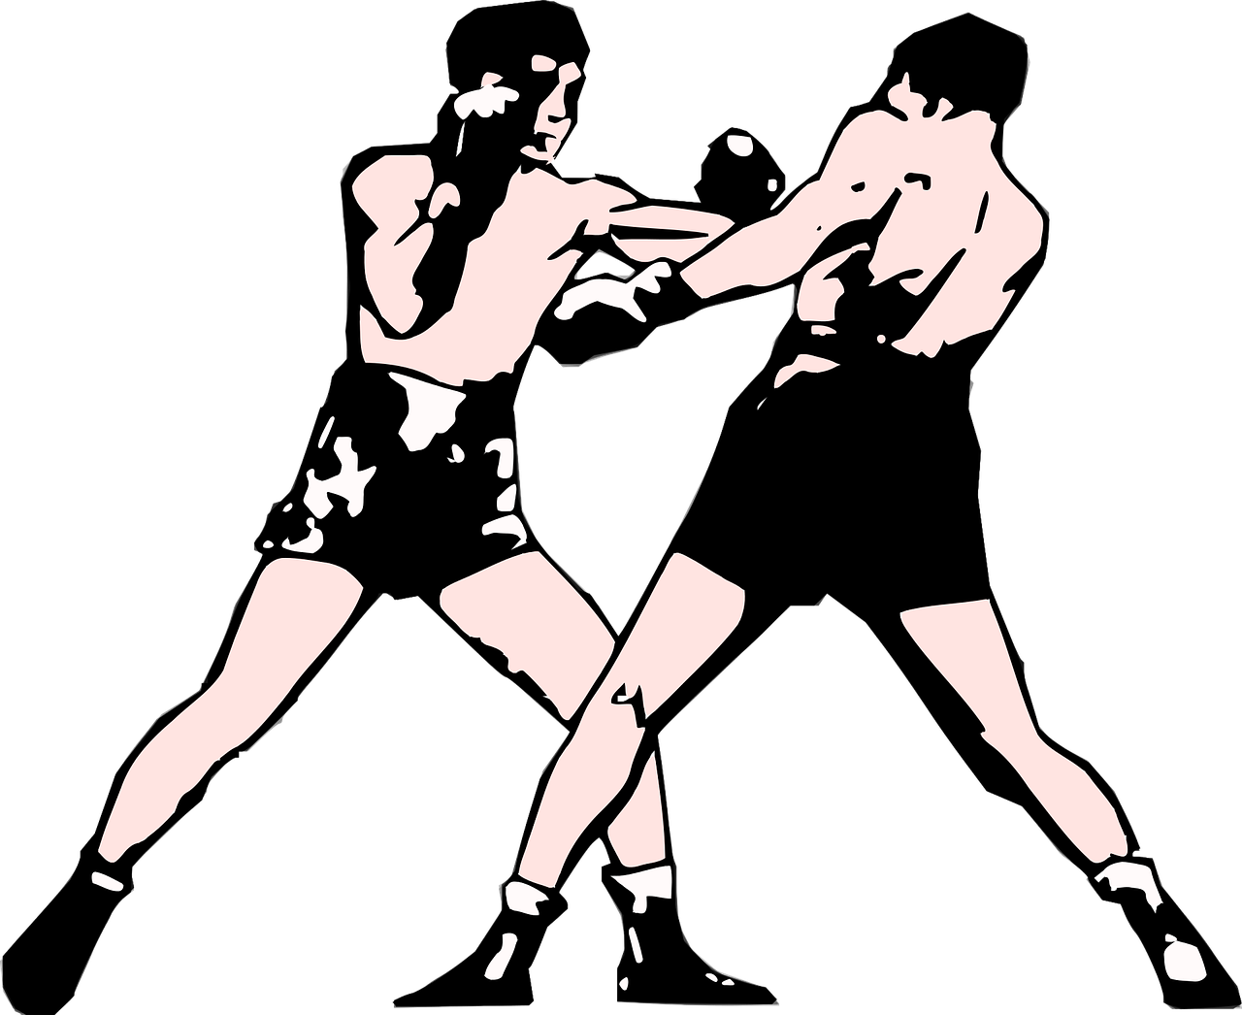
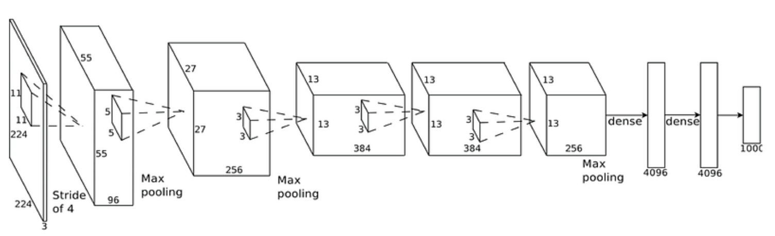
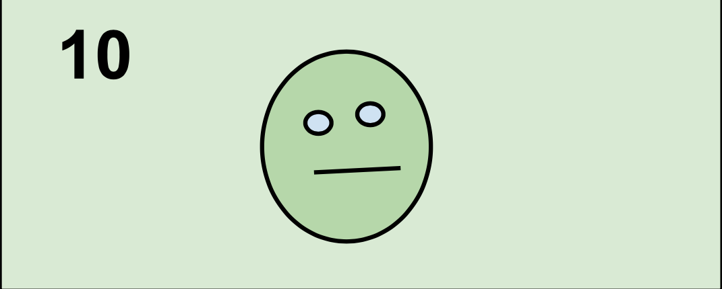
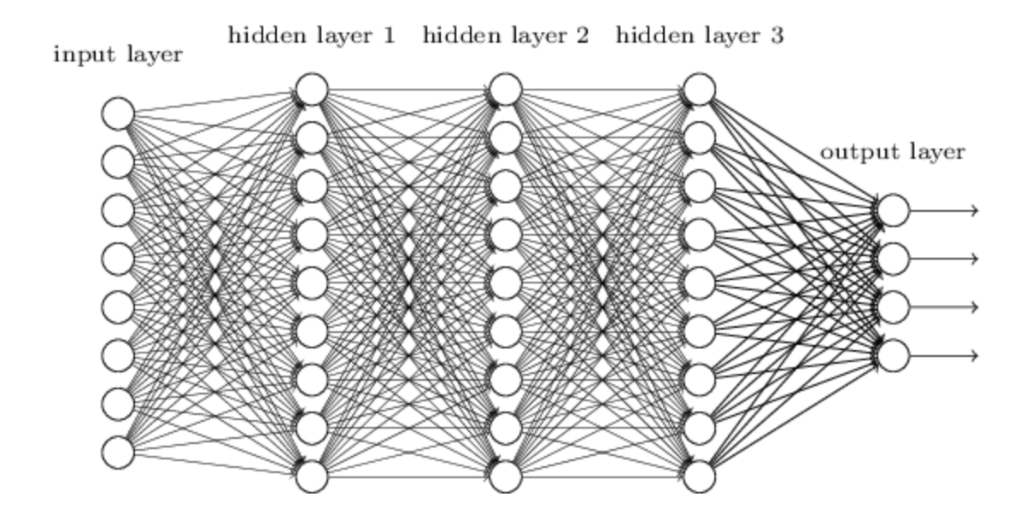
General Structure
Generative Adversarial Networks
The generative part of GANs is responsible in creating fake data.Its main purpose is to make the discriminator classify it as real samples. The main application of GANs is to create fake samples that look realistic.
In the adversarial part the generators goal is to maximize the error probability of the discriminator while the discriminators goal is to minimize its error probability. Through training iterations both networks evolve until they reach an equilibrium state. At this state the discriminator cannot distinguish between real and fake data. This is where the training process ends.
Both the Generator and Discriminator are neural networks. The Generators output is directly connected to the Discriminators input. The network can be either deep convolutional network or fully connected.

Slide 13
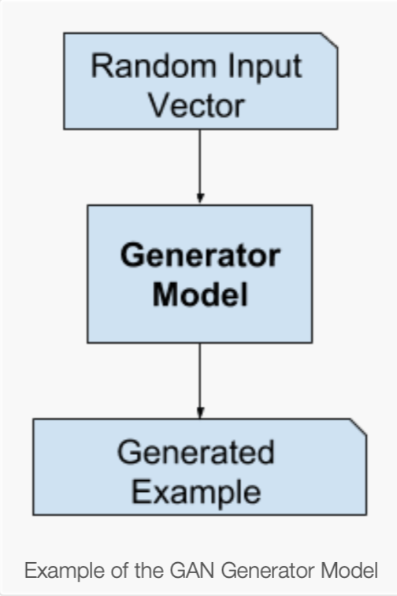
Generator Training Data
Random Input Vector
In GANs the Generators doesn’t use training data like in supervised learning models. Instead the Generator takes a fix-length random vector as input. The vector is also known as “Latent vector” or “noise vector”
This vector is usually sample from a simple probability distribution such as normal or a uniform distribution. The purpose of the random input vector is to provide the Generator with a starting point from which it can generate synthetic data.
This “noise” introduce randomness into the input vector. This is important because it ensures each time the generator generates an output is not exactly as before. The randomness help generate diverse and realistic fake data.

Slide 14
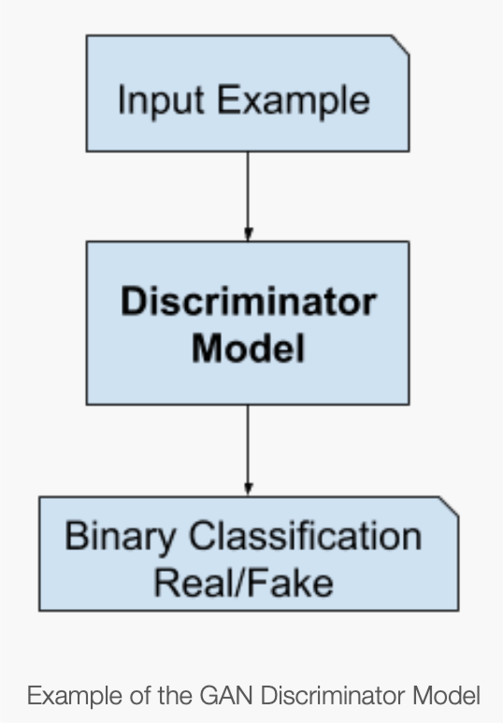
Discriminator Training Data
The Discriminator training data comes from two sources.
Real data samples from the actual data set. Which contain examples of the type of data that the generator tries to imitate. During training the discriminator uses these instances as positive samples.
And fake data samples produced by the Generator. These are the fake data samples that were produced by feeding the generator with the random input vector. During training the discriminator uses these instances as negative samples.
The Generator performs a binary classification on the input data that comes from both the generator’s fake data and real data from the domain set. This classification is typically done using a final output layer with a sigmoid activation function that outputs a probability score. A score close to 1 mean the input instance is real. A score close to 0 mean it is fake.

Slide 15
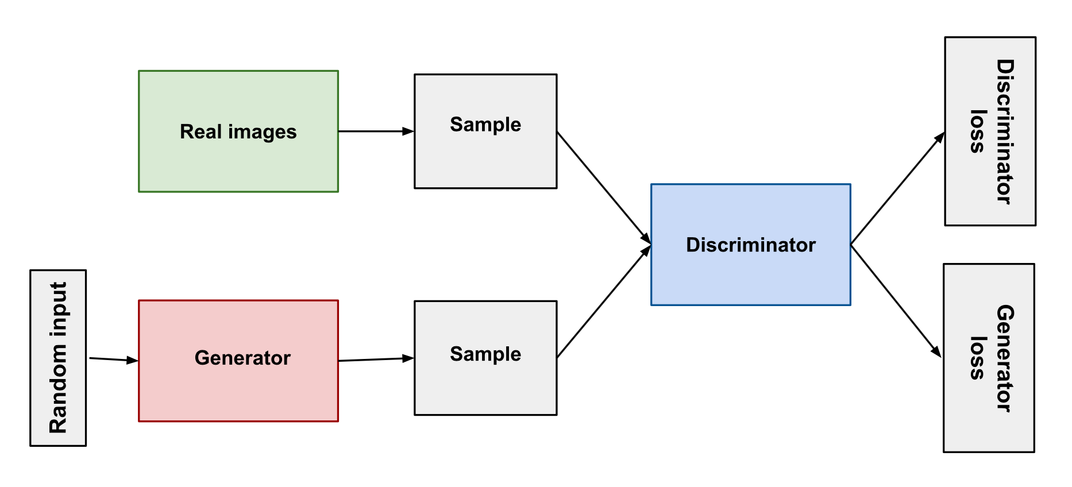
Generator Loss
The Generator loss measures how effectively the Generator is able to deceive the discriminator in classifying the data. The generator loss is typically calculated using a binary cross entropy loss.
The generator loss penalizes the generator when the discriminator classifies the generated examples as fake. When this happens the Generator updates its weights.
In GANs The generator is not directly connected to its loss. The Generators loss is connect to the Discriminators output. This loss is calculated after the Discriminator classifies the data produce by the Generator.

Slide 16
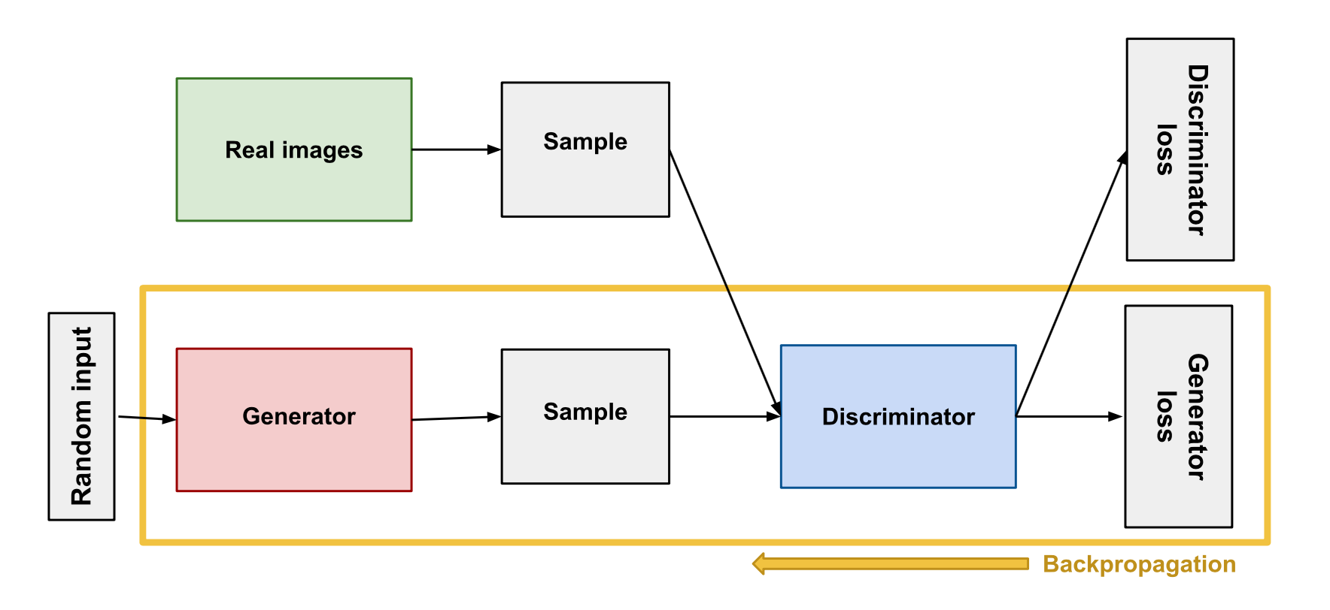
Generator Backpropagation
Once the loss is computed, the gradients of the loss function with respect to the parameters of the generator network are calculated using back propagation. This process involves propagating the error backwards through the network computing the gradients of the loss with respect to each parameter at every layer of the network. After computing the gradients the parameters of the Generator network are updated using a optimization algorithm such as stochastic gradient descendent or adam.

Slide 17
Discriminator Loss
The Discriminator loss measures how effectively the Discriminator network can distinguish between real data and and fake data produced by the generator. The Discriminator loss is typically calculated using a binary cross entropy loss
The Discriminator loss penalizes the Discriminator for misclassifying the real data as fake and the fake data as real. When this happens the Discriminator updates its weights.
The discriminator perform two separate loss calculations. One loss associated with correctly classifying real samples as real. And the other loss associated with correctly classifying the fake samples as fake. At the end both losses are combined to obtain the total Discriminator loss.

Slide 18
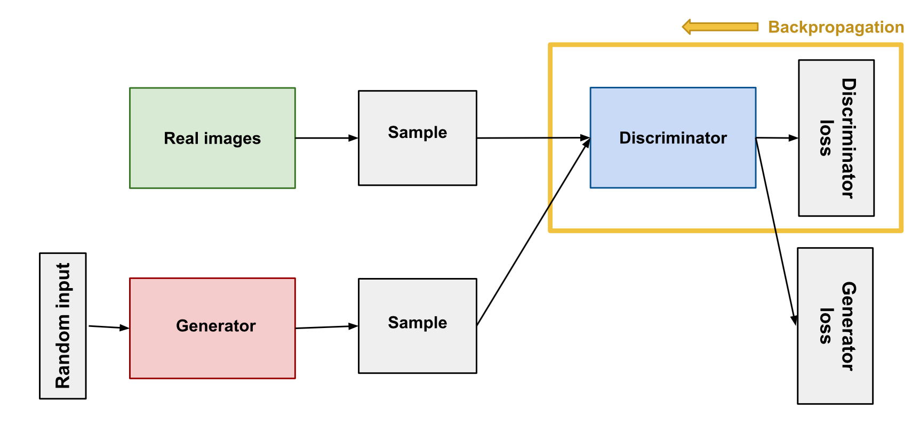
Discriminator Backpropagation
Once the Discriminator loss is computed
the gradients of the loss function with respect of the parameters of the Discriminator network are calculated using backpropagation. This process involves propagating the error backwards through the network. After computing the gradients at each layer of the network. The parameters of the discriminator network are updated using optimization algorithm SGD or adam.

Slide 19
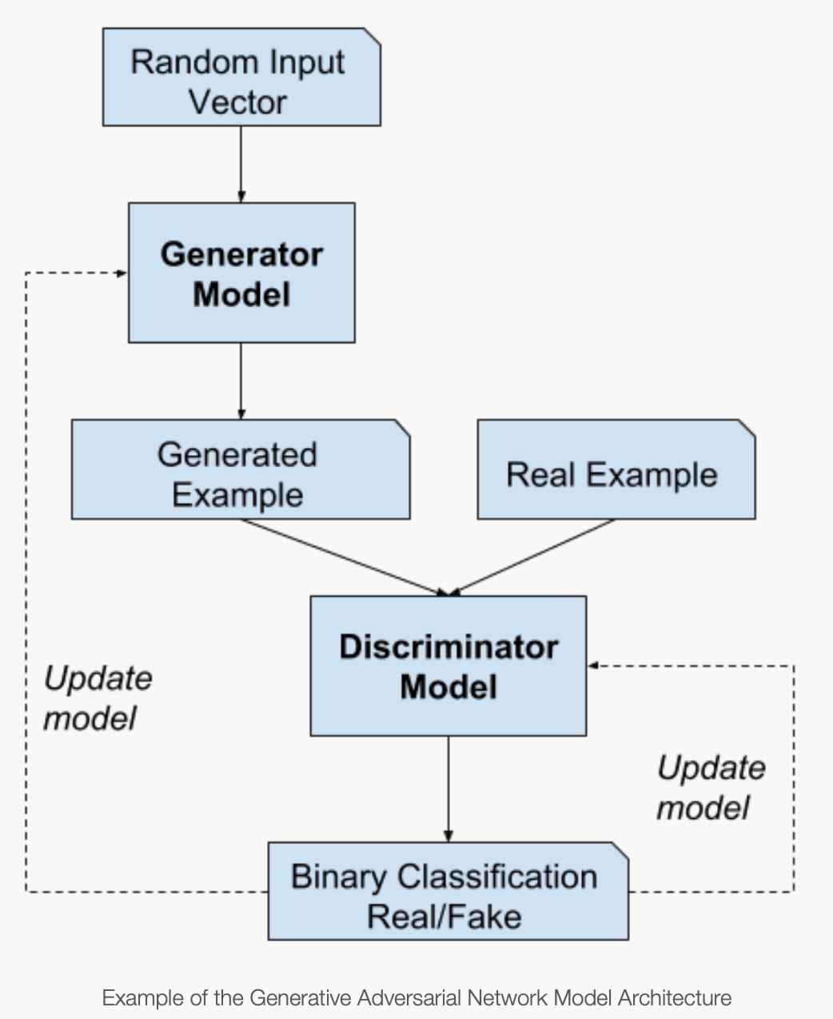
Training
The Generator and Discriminator are trained together. We take both data samples, the fake data produce by the generator and real samples from the domain set and feed them into the discriminator. And have the discriminator classify them as real or fake.
If the Discriminator successfully identifies real and fake samples it is rewarded with no changes to its model parameters. On the other hand if the Generator fails to deceive the Discriminator it gets penalize with updates to its model parameters.

Slide 20
Training continue
Similarly, when the Generator deceive the Discriminator, it gets rewarded with no change to its model parameters. On the other hand the discriminator gets penalize with updates to its model parameters.
After many iterations of training, both the Generator and Discriminator may reach a state where neither can significantly improve their performance. This state is known as equilibrium state or convergence.
At this point the generator becomes good at producing synthetic data that resemble data from the domain set. And the Discriminator is unable to distinguish between real and fake samples.

Slide 21
Algorithms of GANs

Slide 22
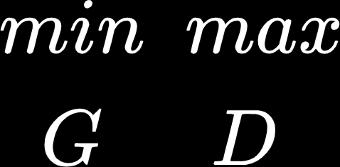
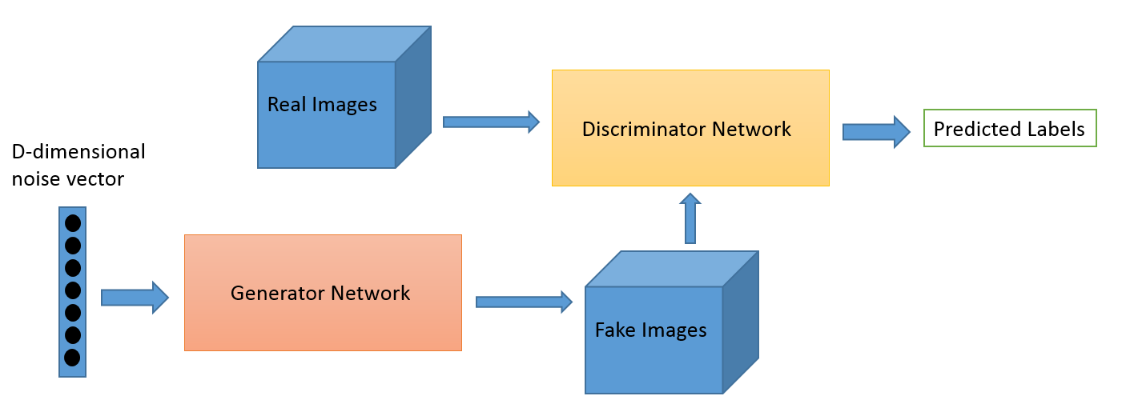
D and G play the following two-player minimax game with value function V(G,D):

Slide 23
D and G play the following two-player minimax game with value function V(G,D):
D
D(x)
x
D(G(z))
z
G(z)
G

Slide 24
D and G play the following two-player minimax game with value function V(G,D):
D
D(x)
x
D(G(z))
z
G(z)
G

Slide 25
D and G play the following two-player minimax game with value function V(G,D):
D(x) = probability that x came from the data rather than p_{g} (generator’s distribution)
Train D to maximize the probability of assigning the correct label to both training examples and samples from G

Slide 26
D and G play the following two-player minimax game with value function V(G,D):
D(x) = probability that x came from the data rather than p_{g} (generator’s distribution)
Train D to maximize the probability of assigning the correct label to both training examples and samples from G
Simultaneously train G to minimize log(1-D(G(Z))

Slide 27
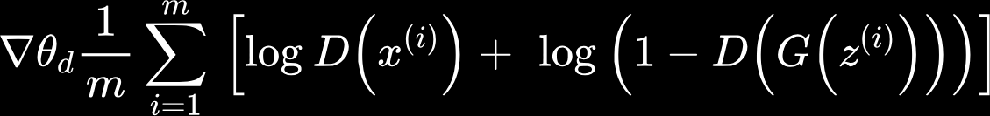
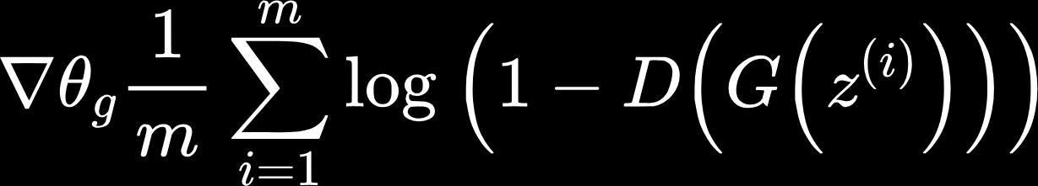
Algorithm
for number of training iterations do
for k steps do
ᐧSample minibatch of m noise samples {z⁽¹⁾, …, z^{(m)}} from noise prior p_{g}(z)
ᐧSample minibatch of m examples {x⁽¹⁾, …, x^{(m)}} from data generating distribution p_{data}(z)
ᐧUpdate the discriminator by ascending its stochastic gradient:
end for
ᐧSample minibatch of m noise samples {z⁽¹⁾, …, z^{(m)}} from noise prior p_{g}(z)
ᐧUpdate the generator by descending its stochastic gradient:
end for

Slide 28
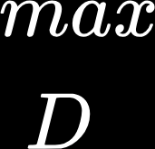
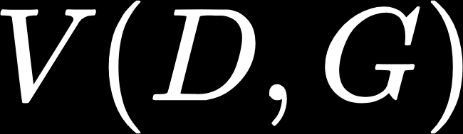
Algorithm
for number of training iterations do
for k steps do
ᐧSample minibatch of m noise samples {z⁽¹⁾, …, z^{(m)}} from noise prior p_{g}(z)
ᐧSample minibatch of m examples {x⁽¹⁾, …, x^{(m)}} from data generating distribution p_{data}(z)
ᐧUpdate the discriminator by ascending its stochastic gradient:
end for
ᐧSample minibatch of m noise samples {z⁽¹⁾, …, z^{(m)}} from noise prior p_{g}(z)
ᐧUpdate the generator by descending its stochastic gradient:
end for

Slide 29
Algorithm
for number of training iterations do
for k steps do
ᐧSample minibatch of m noise samples {z⁽¹⁾, …, z^{(m)}} from noise prior p_{g}(z)
ᐧSample minibatch of m examples {x⁽¹⁾, …, x^{(m)}} from data generating distribution p_{data}(z)
ᐧUpdate the discriminator by ascending its stochastic gradient:
end for
ᐧSample minibatch of m noise samples {z⁽¹⁾, …, z^{(m)}} from noise prior p_{g}(z)
ᐧUpdate the generator by descending its stochastic gradient:
end for

Slide 30
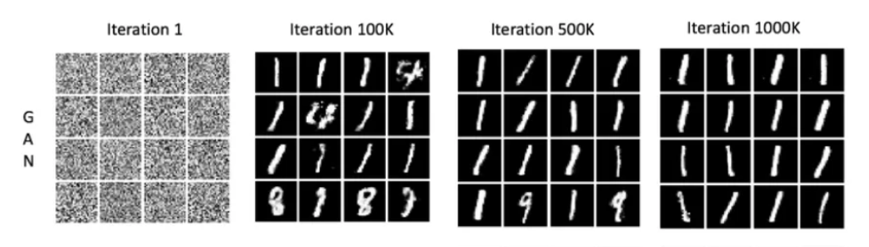
Common Issue with GANS: Mode Collapse
Local minima can be challenging in GANs and may lead to issues like mode collapse.
The generator focuses on producing a limited set of data patterns that deceive the discriminator
Results in repetitive samples
Generated images by GAN models trained on MNIST after 1,100k,500k,1000k iterations.

Slide 31
Mode Collapse: Mitigation Strategies
Wasserstein GANs: extension of traditional GANs that use the Wasserstein distance as the loss function instead of traditional cross-entropy.
provide a more stable and informative training signal, allowing for smoother learning and reduced mode collapse
Unrolled GANs: uses a generator loss function that takes into account not only the current discriminator’s classifications but also the outputs of future discriminator versions.
prevents the generator from over-optimizing for a single discriminator

Slide 32
Forward Propagation (generation and classification)
The generator produces fake data from random inputs
Discriminator separates true data from fake data
Generative
Network
Discriminative
Network
Update generator’s weights to increase classification error
Update discriminator’s weights to decrease classification error
Backward Propagation (adversarial training)

Slide 33
Forward Propagation (generation and classification)
The generator produces fake data from random inputs
Discriminator separates true data from fake data
Generative
Network
Discriminative
Network
Update generator’s weights to increase classification error
Update discriminator’s weights to decrease classification error
Backward Propagation (adversarial training)

Slide 34
Forward Propagation (generation and classification)
The generator produces fake data from random inputs
Discriminator separates true data from fake data
Generative
Network
Discriminative
Network
Update generator’s weights to increase classification error
Update discriminator’s weights to decrease classification error
Backward Propagation (adversarial training)

Slide 35
DCGANs
Deep Convolutional GANs

Slide 36
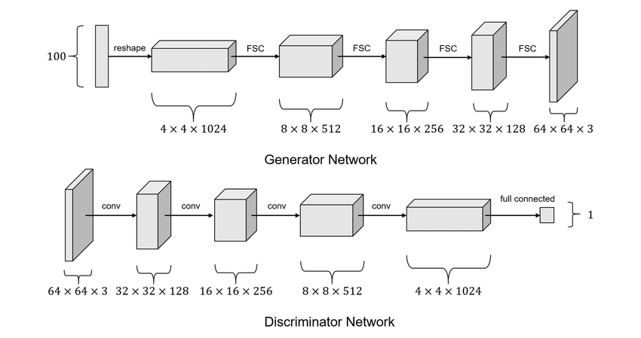
Deep Convolutional GANs (DCGANs)
Type of GAN which uses convolution layers
Designed to generate images

Slide 37
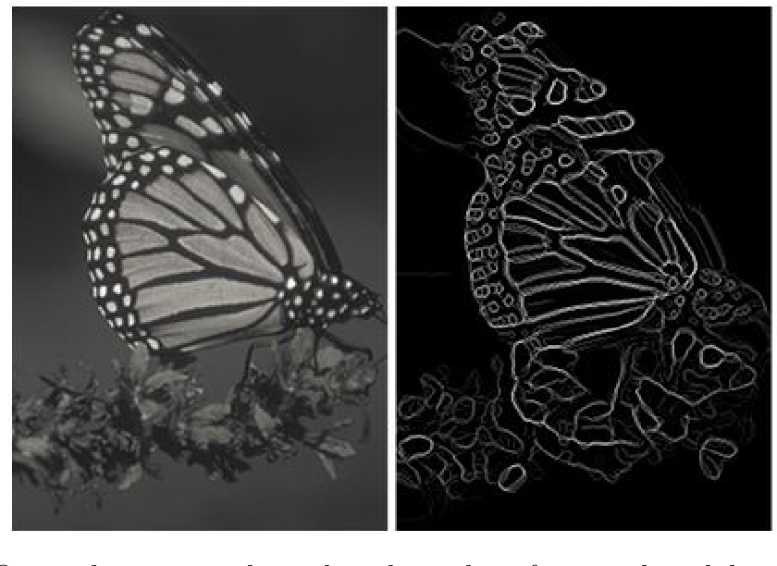
DCGANs - Theory
Convolution
Computers can’t understand patterns in images like we can - eg. spatial, color
Mathematical process to “simplify” images

Slide 38
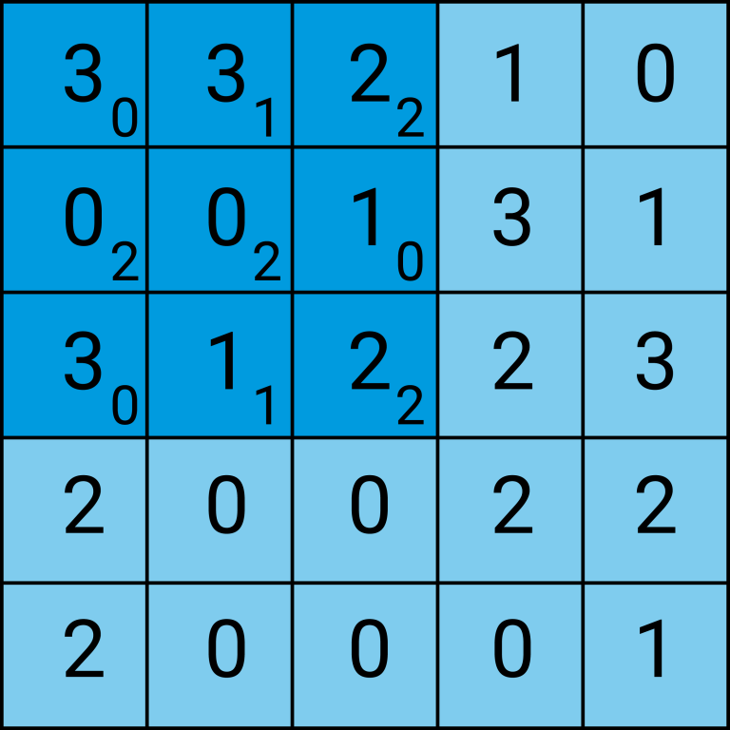
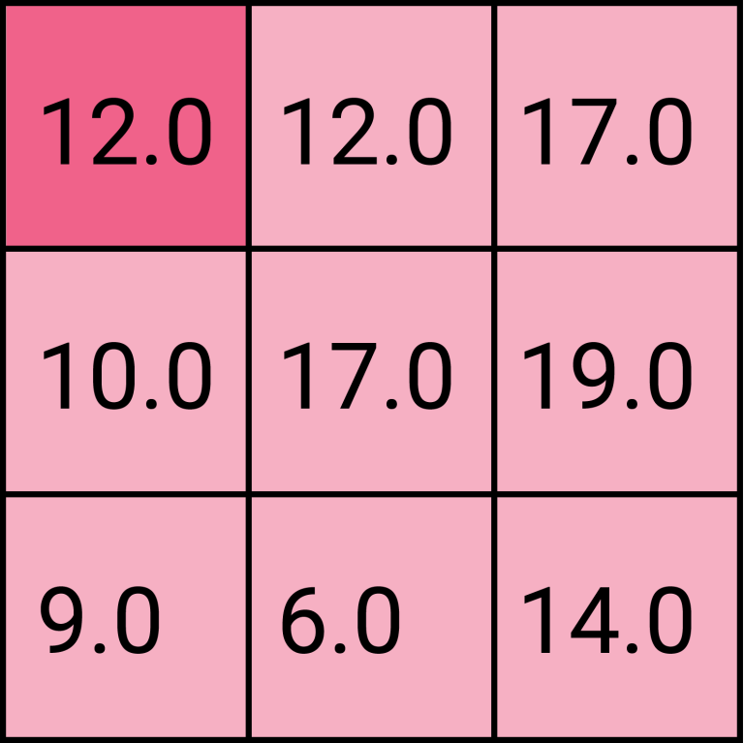
DCGANs - Theory
Convolution (cont.)
Images are filtered using kernels which emphasize edges in a certain direction (or other features)

Slide 39
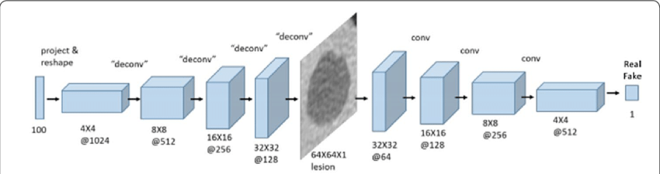
DCGANs - Theory

Slide 40
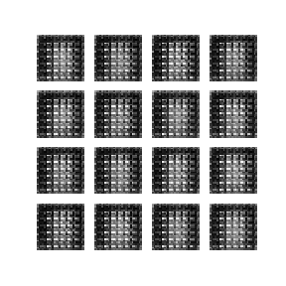
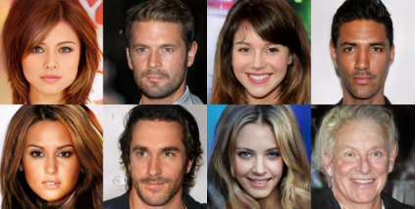
DCGANs - Applications
Image Synthesis

Slide 41
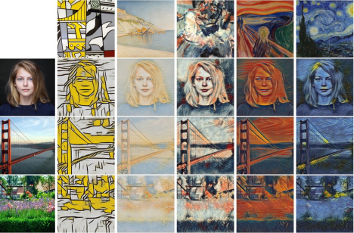
DCGANs - Applications
Style Transfer

Slide 42
DCGANs - Applications
Data Augmentation
Expanding training set of other machine learning models such as CNN by generating similar data
Has been used to improve models where available training data is insufficient

Slide 43
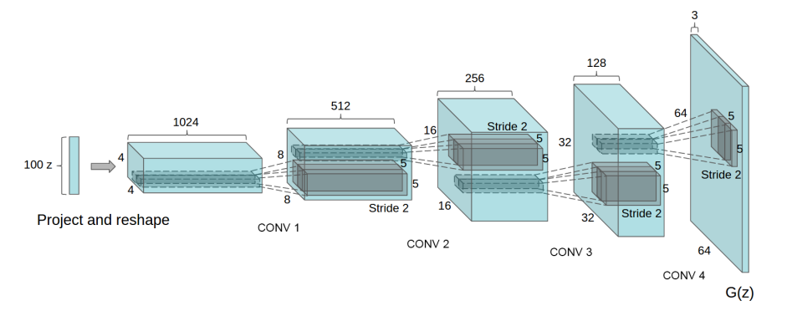
DCGans - Architecture
DCGAN integrates CNN structures to both generator and discriminator with some constraints.
Replace any pooling layers with strided convolutions (discriminator) and fractional-strided convolutions (generator).
Strided convolutions:
Reduces spatial dimensions of feature maps.
Allows network to its own spatial downsampling
Fractional convolution:
Similar to strided but UPSAMPLES.
The first layer takes uniform random values (Z) thats reshaped to 4D tensor for the generator.
Discrimnator: Last layer is flattened an placed in sigmoid output indicating probability of real of fake.
Notes:
1. Additionally, it reduces the architectural complexity by eliminating the need for separate pooling layers, making the network more streamlined and easier to train.
3rd.The purpose of including noise as input to the generator is to introduce variability and randomness into the generated data.
By varying the values of the noise vector Z, the generator can produce a diverse range of outputs, leading to the generation of diverse and realistic-looking data samples.
The generator learns to associate different patterns in the noise vector with different features in the generated data, enabling it to capture complex and diverse patterns during training.

Slide 44
DCGans - Architecture
Use batch normalization in both the generator and the discriminator for every unit (neuron) input.
NOT applied G output layer and D input layer.
Helps gradients flow (deep models) and prevent generator collapse.
Remove fully connected hidden layers for deeper architectures.
Reduce parameters
GAN Impact: Allows to better learn from spatial features.
Use ReLU activation in generator for all layers except for the output, which uses Tanh.
Use LeakyReLU activation in the discriminator for all layers
Regular GAN would use maxout activation
Notes:
1st. Generator Collapse: happens when the generator network fails to produce a diverse range of outputs and instead collapses to generating only a few or even a single output pattern repeatedly.
3rd. Relu F(x) = max(0,x). Promotes sparsity and preventing vanishing gradient.
TanH: Bounded output range -1 to 1.
Helps output values withing a specific range. Which is suitable for certain data distributions, such as color values in images.

Slide 45
DCGANs - Architecture
Generator Discriminator
Notes:
Generator left side:
Input: The generator begins with a random noise vector of size 100.
Projection and Reshaping: This noise vector is first projected into a denser layer and then reshaped, forming the foundation for the upcoming layers.
Transposed Convolutions ("deconv"): The reshaped vector goes through several layers of transposed convolutions. These layers progressively upsample the input vector, increasing its dimensionality to produce a two-dimensional image structure
Output: The final layer outputs a 64x64x1 image, which represents the generated fake image.
Discriminator (Right Side)
Input: The discriminator takes in an image, which could be real or generated by the generator.
Convolutional Layers: It consists of several convolutional layers that act as feature extractors. These layers perform the opposite operation of the generator's transposed convolutions:
Output: The last convolution layer is flattened and then passed through a final output layer with a single neuron, which uses a sigmoid activation function to output a probability score indicating whether the input image is real or fake.

Slide 46
CGANs
Conditional GANs

Slide 47
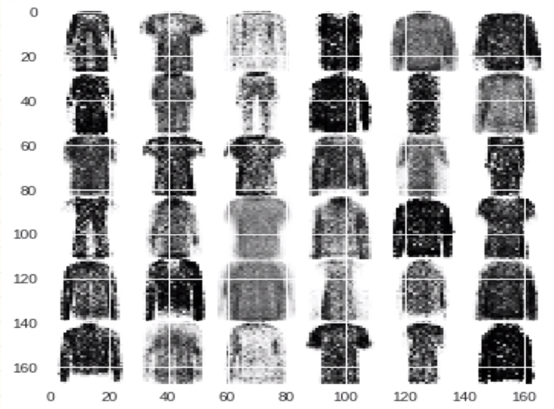
Conditional GANs - Theory
GANs do not allow for control of output type
Introduce conditional variables in addition to the noise distribution in order to allow control of outputs
Goal: Generate synthetic data conditioned on conditional variables

Slide 48
Conditional GANs - Algorithm
Addition of conditional variable, could be any kind of auxiliary information, such as class labels or data from other modalities
Perform the conditioning by feeding y into the both the discriminator and generator as additional input layer
Generator: noise p_{z}(z), and y are combined in joint hidden representation
Discriminator: x and y are presented as inputs and to a discriminative function allow the specification of a characteristic
Goal: make synthetic data indistinguishable from real data to the discriminator given conditional variables

Slide 49
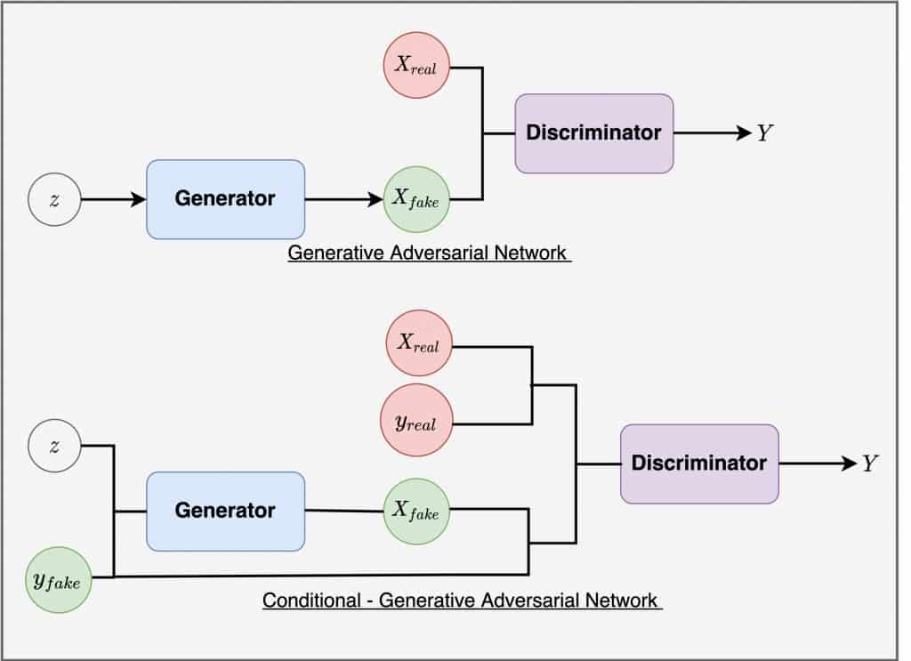
Conditional GANs - Architecture

Slide 50
Conditional GANs - Loss function
GAN Loss Function
CGAN Loss Function
Similar to GAN loss function, added we take into account the condition y, when calculating the loss for each part

Slide 51
Conditional GANs - Training
Generator and Discriminator trained in tandem iteratively using back propagation
Generator
Given a label and random noise distribution input, this network generates data with the same structure as the training data observations corresponding to the same label.
The generator is trained to generate synthetic data given conditional variables, i.e. labels, that "fools" the discriminator.Trying to maximise the error of the discriminator
Discriminator
Given batches of labeled data containing both observations from the training data and generated data from the generator, this network attempts to classify the observations as "real" or "generated".
The discriminator is trained to distinguish between real and generated datagiven conditional variables, i.e. labels, Trying to maximize it's correct predictions on synthetic data

Slide 52
Conditional GANs - Advantages
Mode Collapse Avoidance: CGAN can help mitigate mode collapse by leveraging the use of labels in the training state. By training on diverse set of input variables we can create models avoid producing only a limited range of outputs from the data distribution
Multi-Modal Learning: GAN allow for one to one mappings from input to output but a CGAN can allow for more complex one to many mappings from inputs to outputs.
Example: Create a model to predict labels to use in training for the input labels
Input is taken to be the conditioning variable and the one-to-many mapping is instantiated as a conditional predictive distribution
Any kind of auxiliary information, such as class labels or data from other modalities
Automated tagging of images, with multi-label predictions
Conditional Adversarial Networks to generate a distribution of tag-vectors conditional on image features

Slide 53
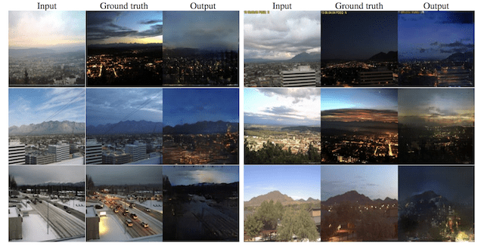
Conditional GANs - Applications
Translation
Image-to-image translation
Day to Night translation
Sketches to color (pix2pix)
Semantic-image-to-photo translation
Example of Photographs of Daytime Cityscapes to Nighttime With pix2pix.Taken from Image-to-Image Translation with Conditional Adversarial Networks, 2016.
Source: https://machinelearningmastery.com/impressive-applications-of-generative-adversarial-networks/

Slide 54
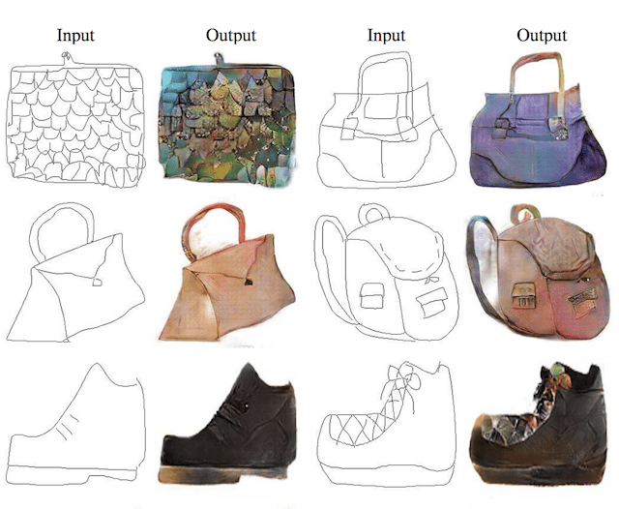
Conditional GANs - Applications
Translation
Image-to-image translation
Day to Night translation
Sketches to color (pix2pix)
Semantic-image-to-photo translation
Example of Sketches to Color Photographs With pix2pix.Taken from Image-to-Image Translation with Conditional Adversarial Networks, 2016. Source

Slide 55
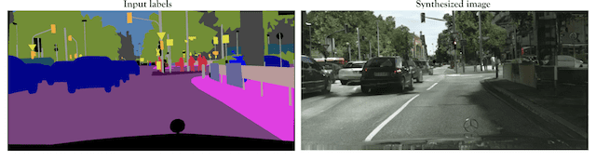
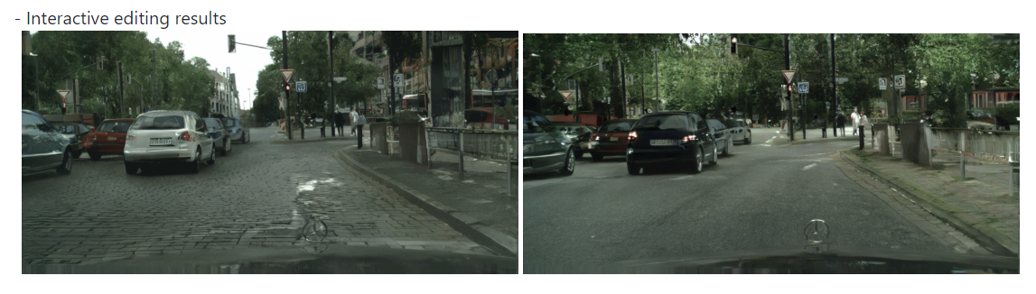
Conditional GANs - Applications
Translation
Image-to-image translation
Day to Night translation
Sketches to color (pix2pix)
Semantic-image-to-photo translation
Semantic Image to Generated Cityscape Photograph Source
Images edited with pix2pixHD (Car colors, shadow, bricks to asphalt) UC Berkeley Ph.D. Source

Slide 56
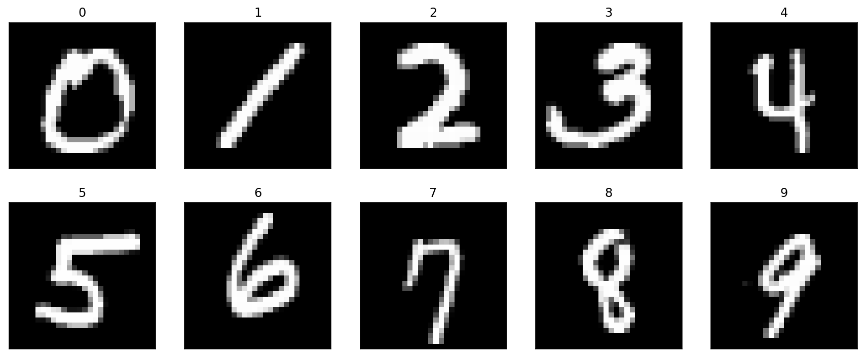
Conditional GANs - Demo
MNIST Digits Dataset

Slide 57
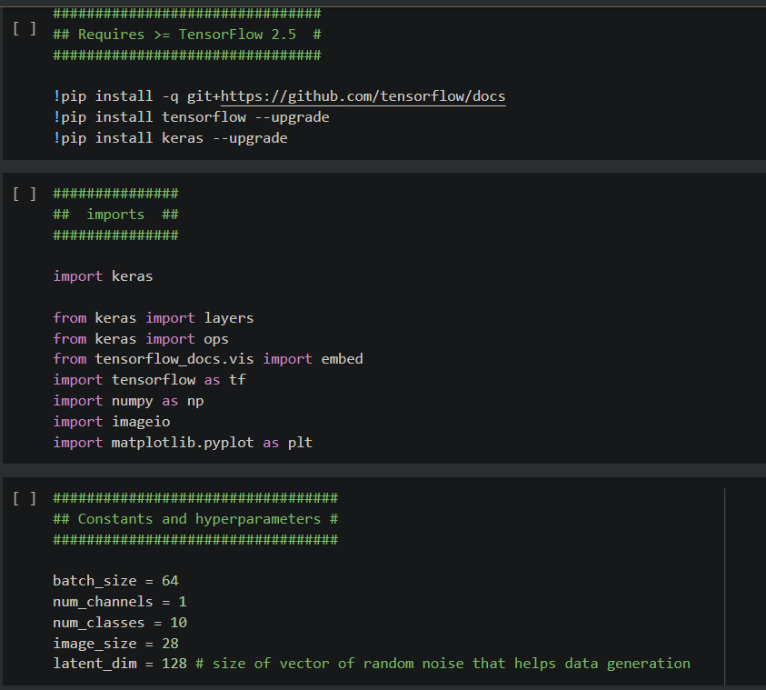
Imports and Set up

Slide 58
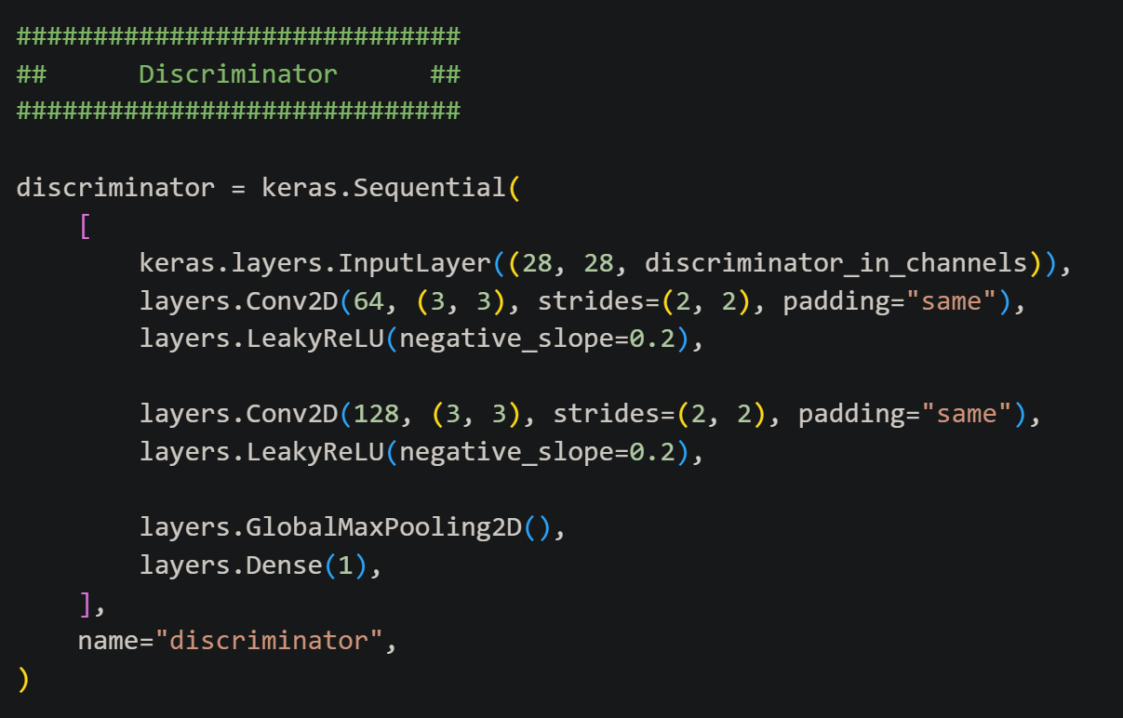
Discriminator

Slide 59
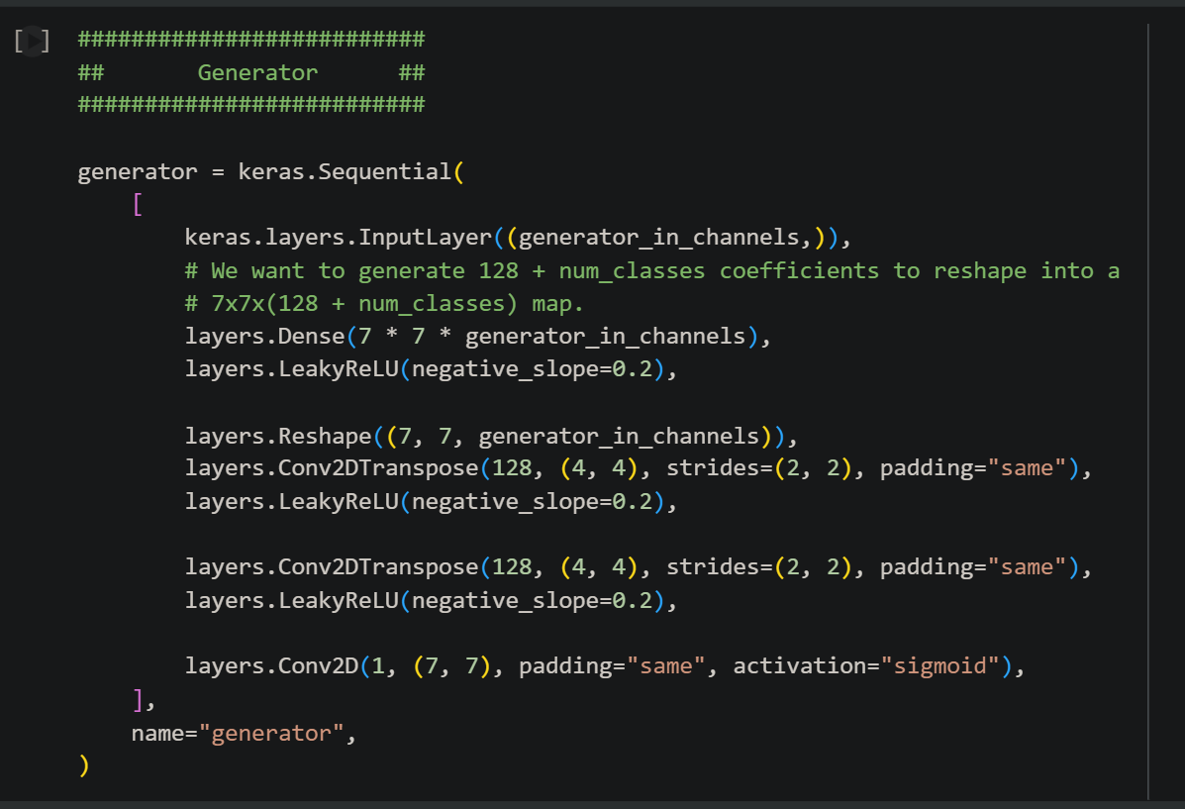
Generator

Slide 60
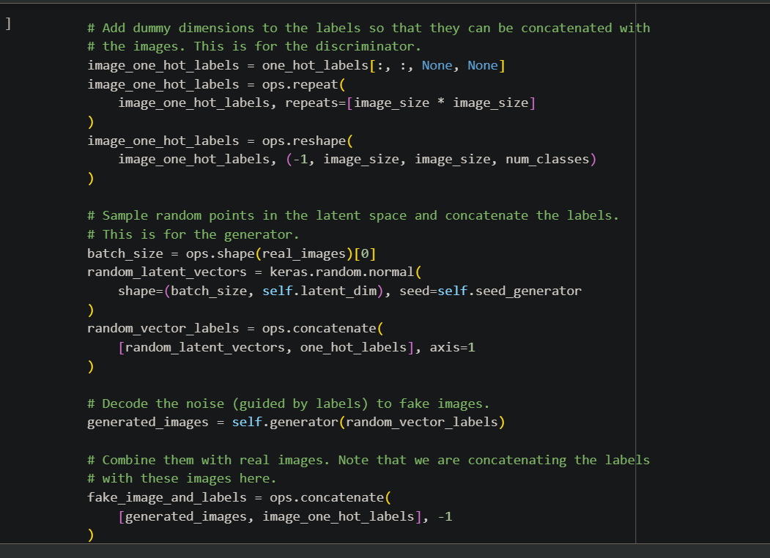
Snippet of training step

Slide 61
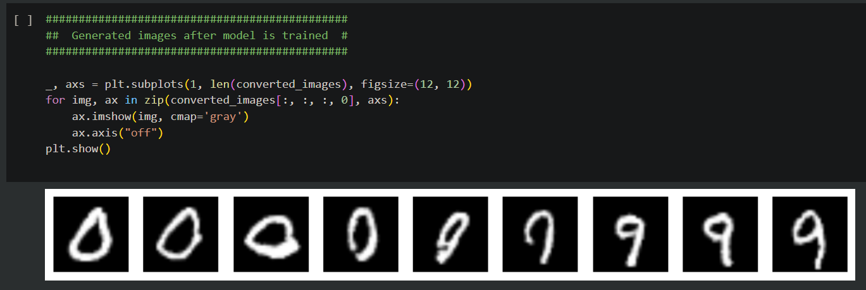
Results: Interpolation Vector
Colab Link: (Original)

Slide 62
Applications of GANS

Slide 63
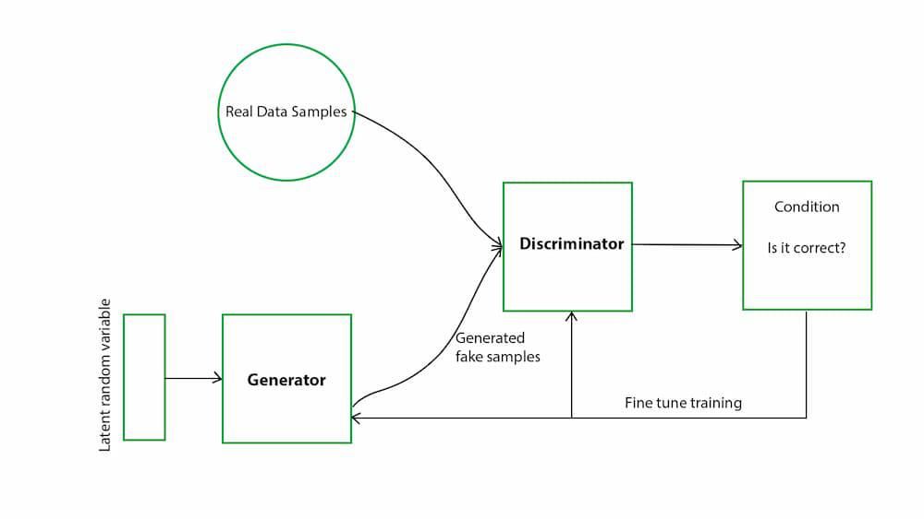
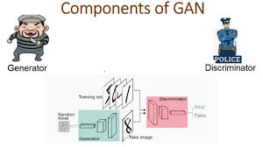
Applications of GANS
Image Generation
Image to Image translation - CycleGan
Image Manipulation - Drag your Gans
Music Generation
MuseGan
Cyber Security
Malware Example Generation - MalGan
Malware Generation - MalFox

Slide 64
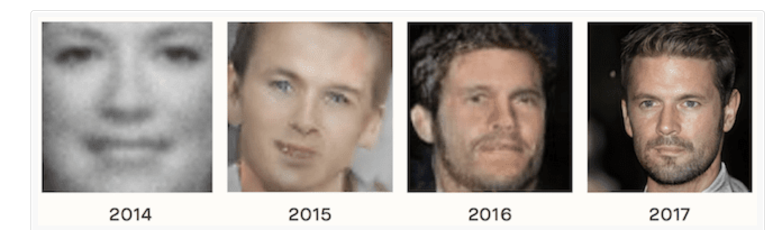
Image Generation
During 2014 - 2017 What happened?
Training GANs via stochastic gradient methods remains unstable and prone to a variety of failure modes
A patchwork of methods has emerged; specialized techniques—uniquely suited to different domains
Different techniques were created to deal with mode collapse, non-convergence, and instability
Notes:
have enabled GANs both to expand to a diversity of new domains and to continuously improve on the state-of-the-art in classical areas such as image generation.

Slide 65
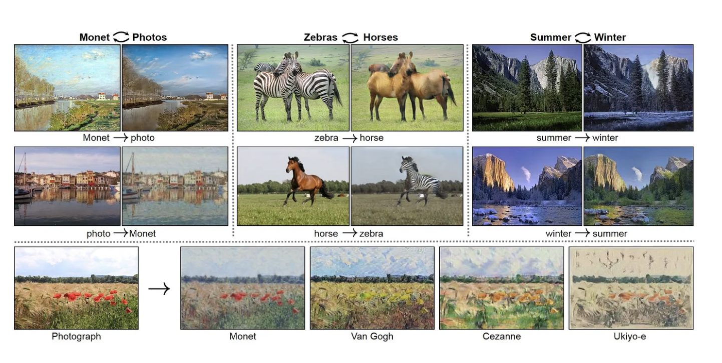
Image to Image translation - “CycleGan”
CycleGan
Converts an image from one domain to another domain- while retaining the same context
The images in the data are unpaired
2 data sets that don't overlap
2 Generators
Generator 1:
Goal to ensure the translated image looks like a the image from the second domain
Generator 2:
Used to convert the translated image back to the original domain
Reconstruction objective - makes sure that the image is similar enough to the first image
Discriminator
Takes an image an input and outputs a single number (Whether or not it thinks the image is fake)
Notes:
Don’t talk about this too much in depth because the next weeks group will talk about it.

Slide 66
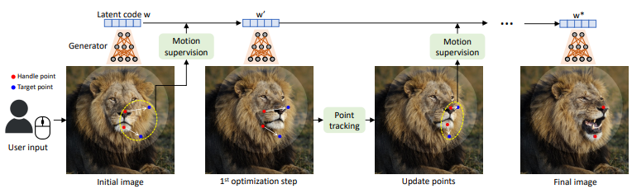
Image manipulation- “Drag Your GAN”:
Derived from a model called StyleGans
Manipulate an image by dragging points and then getting points around the red point to move closer to the blue point as well
See what features are the closest to that selected point and then translate them
Discriminator determines whether or not the image is real or fake given the translation
Notes:
https://learnandburn.ai/p/how-to-train-a-drag-gan#:~:text=GANs%20are%20trained%20using%20a,DragGAN's%20case%2C%20fake%20images).

Slide 67
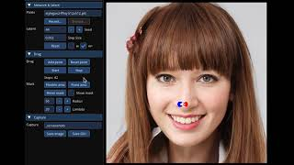
Drag Your Gans Demo

Slide 68

Music Generation with Gans- “Musegan”
Tried 3 different approaches for the generator:
Jamming model
Multiple generator work independently , M generators and M discriminator
Every generator needs a discriminator
Composer Model
One single generator generates multiple channel piano roll
One discriminator
Hybrid Model
A mix of the two models, M generators BUT 1 discriminator
Cons:
Discriminator is not as good as a human at recognizing real music
Sometimes the generator would generate the same patterns monotonously
Notes:
https://ieeexplore.ieee.org/stamp/stamp.jsp?tp=&arnumber=9581146
https://salu133445.github.io/musegan/model
Ie. patterns, repeating parts of a song.
https://arxiv.org/pdf/1709.06298.pdf
MuseGAN typically operates on a representation of music called a piano-roll matrix. In this matrix, each row represents a different pitch, and each column represents a time step. The values in the matrix indicate whether a note is being played for each pitch at each time step. This representation allows MuseGAN to capture the temporal evolution of musical notes across multiple tracks
- which is easily recognizable to not being authentic to humans

Slide 69
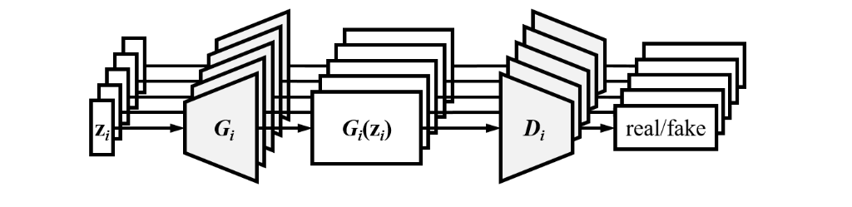
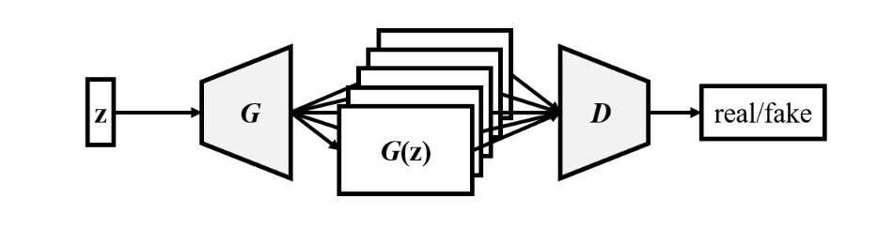

Jamming Model:
Composer Model
Hybrid Model

Slide 70
DEMO For Musegan
https://salu133445.github.io/musegan/results

Slide 71

Malware and Cybersecurity
2 models we will go over
MalGan
MalFox
Why would we want to Generate Adversarial Examples of Malware?
Improve current malware detection

Slide 72


Malware Example Generation-“MalGan”
Does not actually generate malware
Takes the concatenation of a malware feature vector m and a noise vector z as input.
ONLY adds irrelevant features to the malware
Removing API calls will not allow the malware to do its job as being a malware.
Generator:
Multi-layer feed-forward
Discriminator ( Black Box Detector)
“Authors know nothing about the detailed structure of the black-box detector”
Substitute Detector :
Multi-layer feed-forward
Used to fit the Black Box Detector
Provides gradient info to train the generator

Slide 73


Malware Generation-“MalFox”
Actually generates Malware unlike MalGans
Generator:
Produces a perturbation path that is used by PE Editor to construct an adversarial malware example
Perturbation path (Obfusmal, Stealmal, Hollowmal):
alter malware in a way that evades detection while preserving its malicious functionality.
Discriminator
Attempts to precisely distinguish malware and benignware.
The stronger the Discriminator, the more powerful the Generator (and the PE Editor).
Notes:
6.6 MalFox The creation of MalFox, a GAN model for creating attacks and new malware [61] gave an important and powerful tool to those testing or attacking existing systems. MalFox is an amalgamation of parser, generator, and discriminator layers, which takes as input Windows Portable Executable files, or PEs, and outputs the same executables. This makes it a more practical tool that the more common adversarial example generators which often take an image created by a feature extraction process and don’t create functioning malware in pre-approved file types. Since its inception, MalFox has undergone more than one transformation, but even the original version shows the power of GAN-based schemes for attack purposes. The initial experiments were used against pre-trained classifiers – Decision Tree; Random Forest; Logistic Regression; Support Vector Machine; Multi-Layer Perceptron; Vote; Long Short-Term Memory; Bi-directional LSTM; LSTM Average; Bi-LSTM Average; LSTM Attention; and BiLSTM Attention. The evasion rate – the percentage of times the program was classified as benign by the systems - MalFox achieved was 99% minimum across the board. This is a stunning display of the power of these schemes. Furthermore, when tested against the open-access giant VirusShare, the detection rate was only 29.7% on average. The evasion rate on the same was averaged as 56.2%. MalFox and the experiments done show exactly how powerful these schemes can be.
For random forest and decision trees, the TPRs on adversarial examples range from 0.16% to 0.20% for both the training set and the test set, while the TPRs on the original samples are all greater than 93%. When using other classifiers as the black-box detector, MalGAN is able to decrease the TPR on generated adversarial examples to zero for both the training set and the test set. That is to say, for all of the backend classifiers, the black-box detector can hardly detect any malware generated by the generator. The proposed model has successfully learned to bypass these machine learning based malware detection algorithms.

Slide 74

What is used now?
Instead of having GANS, the new state of the art models are the diffusion models.
Video Generation, Image Generation, Music Generation - Diffusion Model transformer

Slide 75
DEMO

Slide 76

Import MNIST data set
Reshape and normalize
Shuffle and batch

Slide 77

Method for building generator

Slide 78

Method for building discriminator

Slide 79


Set up optimizers and use Binary Cross Entropy
Create generator discriminator

Slide 80

Set up loss functions for discriminator and generator

Slide 81


Set up function for each step of training

Slide 82

Set up function for training

Slide 83
https://colab.research.google.com/drive/1BwbqxL2fWI_vAHgWS_4Cxs9Nt6PpltFK#scrollTo=z40pYePYYUBs

Slide 84
Conclusion

Slide 85
Recap
A GAN is a machine learning model in which two neural networks compete with each other using deep learning methods to become more accurate.
Algorithms
Structure of GAN
Ex:

Slide 86
Recap
DCGANs (Deep Convolutional Generative Adversarial Networks) - A DCGAN is a direct extension of the GAN described above, except that it explicitly uses convolutional and convolutional-transpose layers in the discriminator and generator, respectively.
Conditional GAN
Applications of GAN

Slide 87
Types of GANs
Vanilla GANs – simplest type of gans where the generator and discriminator are simple multilayer perceptrons
Deep convolutional GANs (DCGANs) – comprise of convNets and are more stable and generate higher quality images
Conditional gans – CGANs - use extra label information to generate better results
Super resolution GAN – generate a photorealistic high resolution image when given a low resolution image

Slide 88

Important Application Of GANs
Generating cartoon characters (DCGANS)
Generare human faces (GANs)
Text to image translation – build realistic images from textual descriptions of simple objects like birds (DeepAI.org)
3D object generation – popular in game design , 2d objects into multiple

Slide 89

More Resources
The internet
https://www.coursera.org/articles/what-is-gan
https://shelf.io/blog/gans-explained-how-generative-adversarial-networks-work/
https://machinelearningmastery.com/what-are-generative-adversarial-networks-gans/
https://arxiv.org/abs/1411.1784
https://www.tensorflow.org/tutorials/generative/dcgan https://machinelearningmastery.com/what-are-generative-adversarial-networks-ga
University of Youtube
DCGAN EXPLAINED https://www.youtube.com/watch?v=EYrt7fGyA08
What are GANs? https://youtu.be/TpMIssRdhco?si=3_TLgM7HFZ_VHWhk
Dr. Pourhomayoun

Slide 90
THANK YOU

